Slide 1
Airline Delay

Slide 2
Team members
Team Member | ID
Youssef Shaaban El-Sayed | 20201701163
Youssef Mohamed Mansour | 20201701036
Maryam Reda Ali | 20201701218
Marwa Sameh Ali | 20201700799
Eman Mamdouh Awad | 20201701063

Slide 3
INTRODUCTION
The dataset at hand provides a comprehensive overview of airline delays in the United States during Months 8,9,10,11,12 for the years 2019 ,2020,2021,2022 and 2023, offering detailed insights into the performance of various carriers at different airports.

Slide 4
DATASET FEATUERS
Year and Month: The dataset includes information for two consecutive years, 2019 ,2020,2021,2022 and 2023, with a numeric representation of the month.
Carrier and Carrier Name: Identifies the airline carrier and provides its name.
Airport and Airport Name: Specifies the airport code and name, respectively.
Arrival Flights (arr_flights): Indicates the total number of flights arriving at the airport.
Arrival Delays Over 15 Minutes (arr_del15): Represents the number of flights arriving more than 15 minutes late.
Carrier Count (carrier_ct): Breaks down the number of delays attributed to the air carrier, such as issues with crew availability.
Weather Count (weather_ct): Describes the number of delays caused by inclement weather.
NAS Count (nas_ct): Specifies the number of delays attributed to the National Aviation System, including heavy air traffic.
Security Count (security_ct): Represents the number of flights canceled due to a security breach.

Slide 5
DATASET FEATUERS (CON.)
Late Aircraft Count (late_aircraft_ct): Indicates the number of flights delayed as a result of another flight on the same aircraft being delayed.
Arrival Cancelled (arr_cancelled): Reflects the number of canceled flights.
Arrival Diverted (arr_diverted): Specifies the number of flights that were diverted.
Total Arrival Delay (arr_delay): Sum of the total time (in minutes) for all delayed flights.
Carrier Delay (carrier_delay): Total time (in minutes) of delay specifically due to air carrier issues.
Weather Delay (weather_delay): Total time (in minutes) of delay caused by inclement weather.
NAS Delay (nas_delay): Total time (in minutes) of delay attributed to the National Aviation System.
Security Delay (security_delay): Total time (in minutes) of delay due to security issues.
Late Aircraft Delay (late_aircraft_delay): Total time (in minutes) of delay resulting from a previous flight on the same airplane being late.

Slide 6

Data preprocessing
1. Converting Numeric Columns to Integer Columns:
The code snippet initiates by converting specific numeric columns within the dataset to integer type. This conversion aims to ensure that columns containing numeric values related to airline-related factors (such as carrier delays, weather-related delays, etc.) are in an integer format, facilitating subsequent calculations and analysis.
2. Removing Missing Values (NA) from the Dataset:
Following the conversion of numeric columns, the code eliminates rows containing missing or 'NA' values from the dataset. This step ensures that the subsequent analysis is performed on a cleaner dataset without any missing values

Slide 7
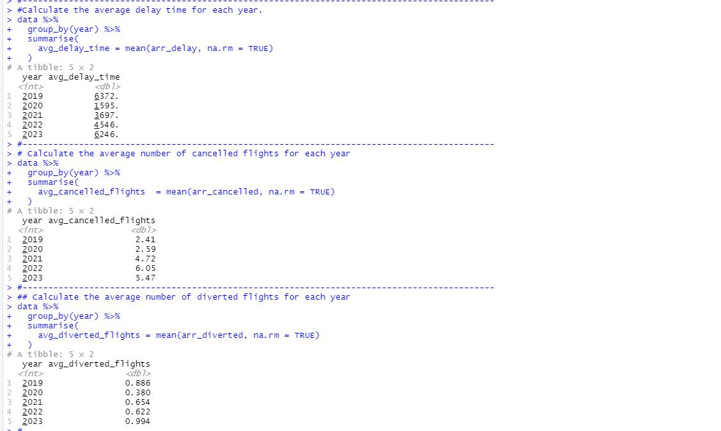
Suitable statistics for our data

Slide 8
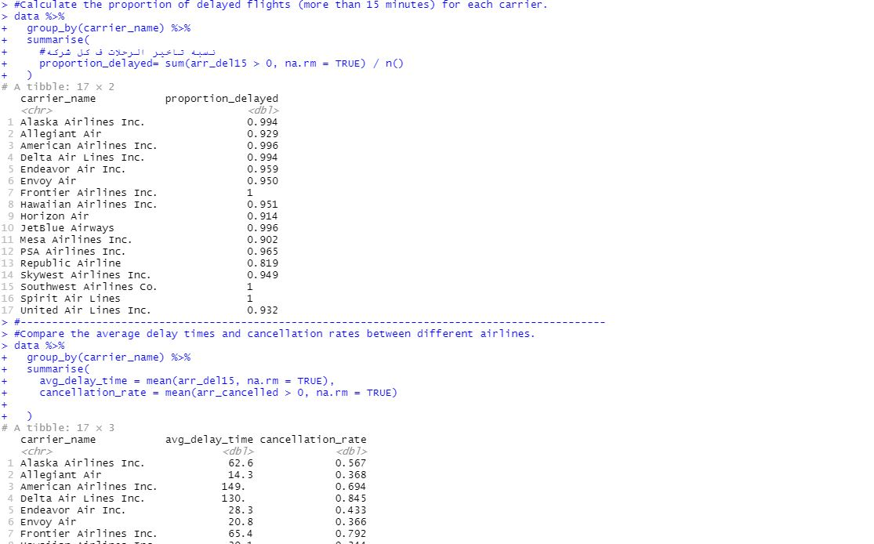
SUITABLE STATISTICS FOR OUR DATA (con.)

Slide 9
Suitable statistics for our data(con.)
1. Average Delays, Cancellations, and Diverted Flights per Year:
The code computes the average number of delays, cancellations, and diverted flights for each year in the dataset. It groups the data by the year column and calculates the sums for the specified columns (arr_delay, arr_cancelled, and arr_diverted), providing insights into yearly flight disruptions.
2.The proportion of delayed flights (more than 15 minutes) for each carrier.
This calculates the proportion of flights delayed by more than 15 minutes for each carrier. It uses the logical condition arr_del15>0 to identify delayed flights and then calculates the ratio of the sum of delayed flights to the total number of flights
3. Compare the average delay times and cancellation rates between different airlines.
Calculates the cancellation rate for each carrier by finding the mean of the logical condition arr_cancelled > 0.

Slide 10
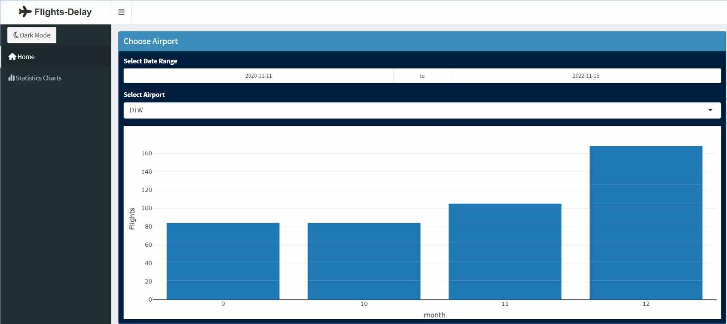
OUR DASHBOARD

Slide 11
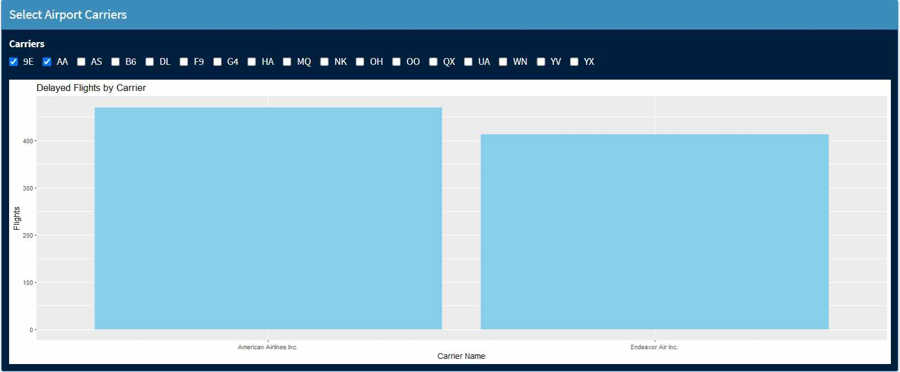
OUR DASHBOARD(con.)

Slide 12
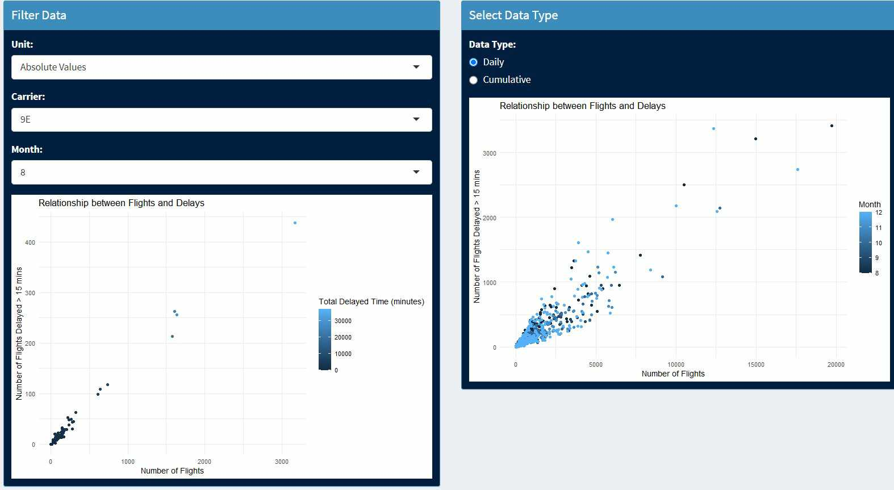
OUR DASHBOARD(CON)

Slide 13
Summary about main components used in dashboard
Dropdown_data: This subset of the data is created based on the selected carrier from the dropdown menu (input$selected_carrier).
checkbox_data: This subset is created based on the selected carriers from the checkbox group (input$selected_carriers).
DataRange_data: This subset is created based on the selected date range (input$date_range).
The renderPlotly function is used to create an interactive bar plot using the plotly library.
The bar plot is created using ggplot with the x-axis representing the years, y-axis representing the number of flights more than 15 minutes late (arr_del15), and tooltips providing additional information.
The resulting ggplot object is converted to an interactive plot using ggplotly, making it suitable for Shiny applications

Slide 14
SUMMARY ABOUT MAIN COMPONENTS USED IN DASHBOARD(con.)
The output$weather_delay_plot is a reactive expression that renders a plot based on the selected data type (either "Daily" or "Cumulative") using renderPlotly.
For the "Daily" option, a line plot is created showing the weather delay over time.
For the "Cumulative" option, the data is aggregated to show the cumulative weather delay over time.

Slide 15
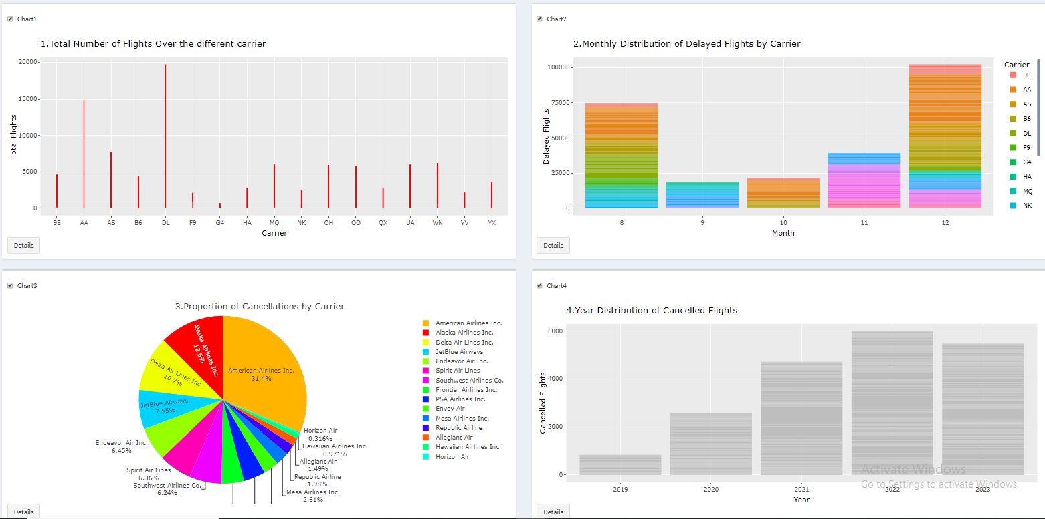
Static Visualizations

Slide 16
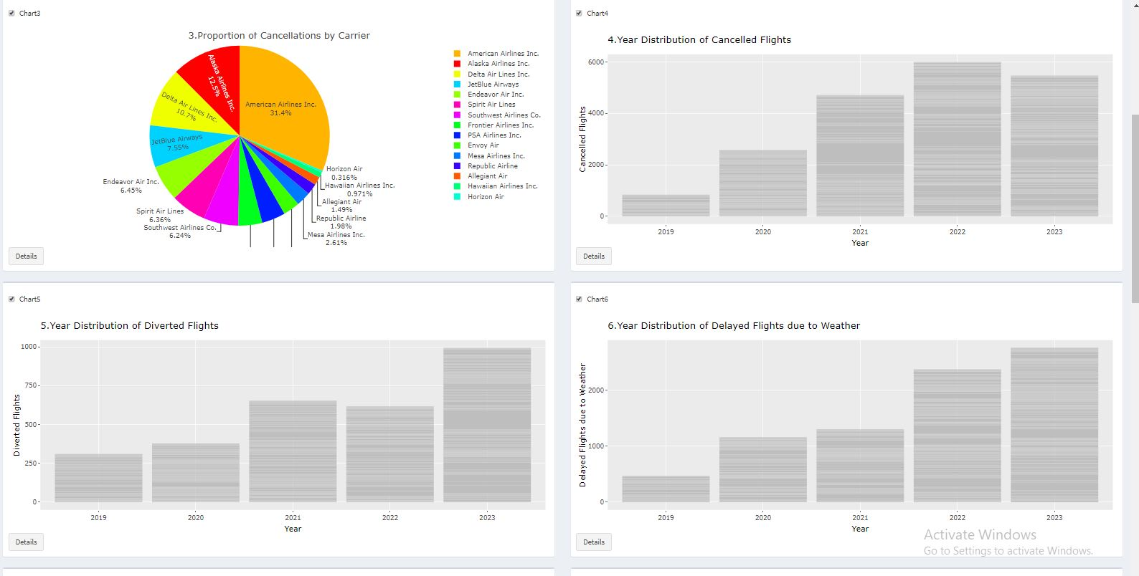
STATIC VISUALIZATIONS(cons.)

Slide 17
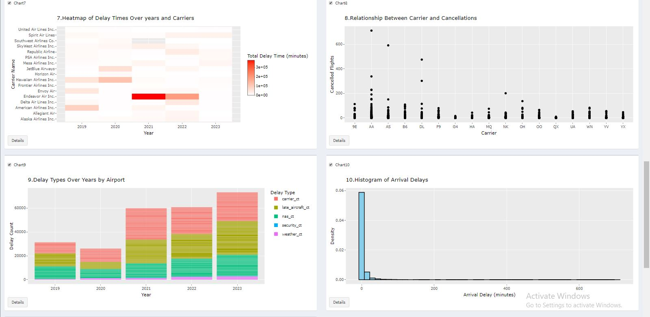
STATIC VISUALIZATIONS(CONS.)​

Slide 18
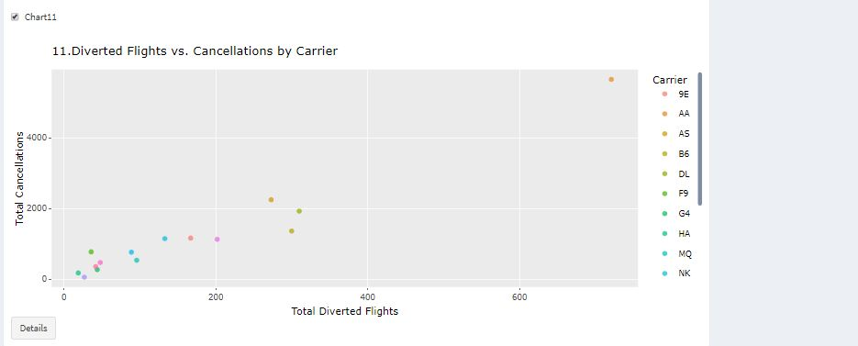
STATIC VISUALIZATIONS(CONS.)

Slide 19
STATIC VISUALIZATIONS(con.)
Chart 1: Total Number of Flights Over Different Carriers:
Line plot showing the total number of flights over different carriers.
Chart 2: Monthly Distribution of Delayed Flights by Carrier:
Stacked bar plot depicting the monthly distribution of delayed flights by carrier.
Chart 3: Proportion of Cancellations by Carrier:
Polar bar chart illustrating the proportion of cancellations by carrier.
Chart 4: Year Distribution of Cancelled Flights:
Bar plot displaying the distribution of cancelled flights over different years.
Chart 5: Year Distribution of Diverted Flights:
Bar plot showing the distribution of diverted flights over different years.
Chart 6: Year Distribution of Delayed Flights due to Weather:
Bar plot indicating the distribution of delayed flights due to weather over different years.
Chart 7: Heatmap of Delay Times Over Years and Carriers:
Heatmap representing the total delay times over years and carriers.

Slide 20
STATIC VISUALIZATIONS(CON.)
Chart 8: Relationship Between Carrier and Cancellations:
Scatter plot depicting the relationship between carriers and the number of cancellations.
Chart 9: Delay Types Over Years by Airport:
Stacked bar plot showing different types of delays over years by airport.
Chart 10: Histogram of Arrival Delays:
Histogram illustrating the distribution of arrival delays.
Chart 11: Diverted Flights vs. Cancellations by Carrier:
Bubble chart comparing the total number of diverted flights and cancellations by carrier.

Slide 21
THANK YOU

